Slide 1


Why Empirical Legal Studies?
CELS IIAS
NTU Department of Economics,
Law & Economics
Oct. 16, 2014
Kuo-Chang Huang
Associate Research Professor & Director for Center for Empirical Legal Studies,
Academia Sinica, Taipei.
Adjunct Associate Professor, Department of Economics,
National Taiwan University.

Slide 2
For the rational study of the law the black letter man may be the man of the present, but the man of the future is the man of statistics and the master of economics.
Oliver Wendell Holmes,
The Path of the Law (1897)

Slide 3
Empirical legal analysis can influence not only individual cases, but also larger policy questions. Much room for progress exists, because misperceptions about the legal system are common.
Theodore Eisenberg (1947~2014)

Slide 4
什麼是法律實證分析？
由當事人利用自然科學的實證分析，作為證據方法，以在案件中取得勝訴
  科學證據(scientific evidence)；DNA
由當事人使用社會科學的實證分析，作為證據方法，以在案件中取得勝訴
  統計證據(statistical evidence)；employment discrimination
採用一定之社會科學研究方法，對法律運作的「經驗現象」，進行有系統的觀察及分析
  經驗的掌握：data collection
  經驗的分析：qualitative v. quantitative analysis

Slide 5
經驗掌握（資訊收集）
官方統計資料
判決編碼（法學資料檢索系統）
  Generally good
  案件選擇 (case selection)
透過「實驗」創造經驗 (Experiment)
  Scott v. Harris, 550 U.S. 372 (2007)
  模擬審判
由研究者第一手自行收集（Field Survey）
  我國勞資爭議／紛爭解決行為

Slide 6
司法院統計資料庫
地方法院辦理民事事件終結事件中平均一件所需日數
適用通常訴訟程序之普通財產權訴訟以判決終結的審理日數
年度 | 平均審理日數（日）
2001 | 111.12
2002 | 106.6
2003 | 96.69
2004 | 85.97
2005 | 71.57
2006 | 56.09
年度 | 平均審理日數（日）
2001 | 260
2002 | 287
2003 | 297
2004 | 285
2005 | 284
2006 | 285
中華民國96年司法統計年報8-12

Slide 7
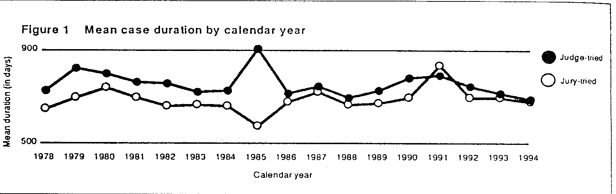
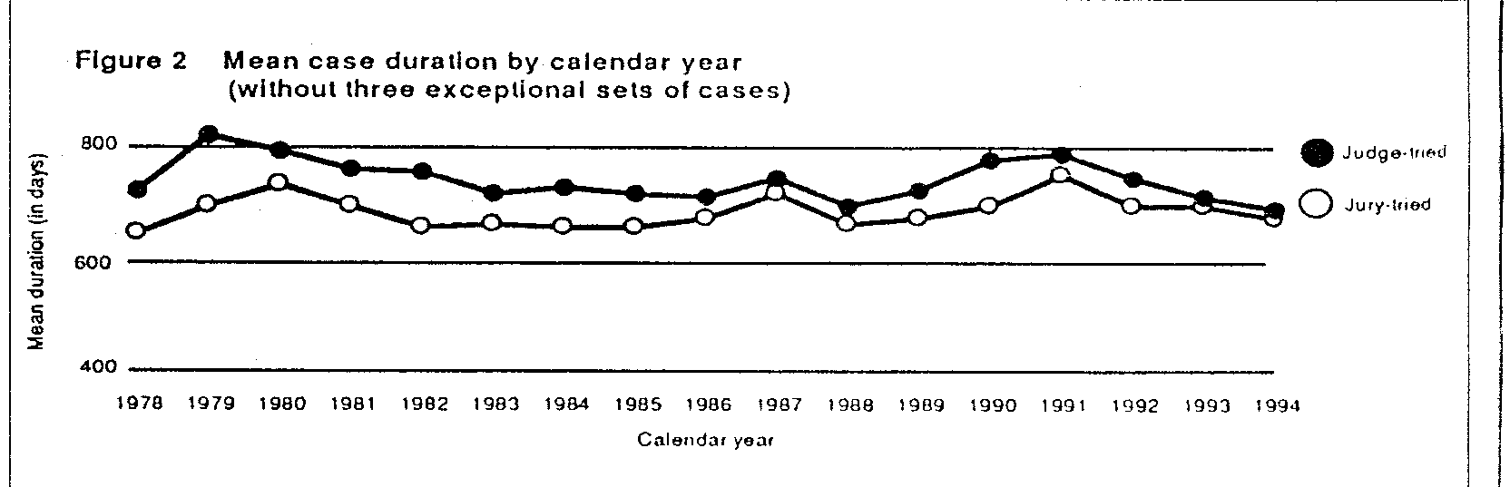
Judge v. Jury: Which One Faster?
  Lesson: Reform aiming to limit jury trial in order to reduce delay is counterproductive

Slide 8

Why Empirical Legal Studies?
Traditionally, legal studies in Taiwan have mainly focused on doctrinal theory.
Examination of the consequences of legal implementation is often neglected.
Whether the law has
  accomplished the regulatory goal
  achieved the intended purposes or produced the expected effects
  has influenced judicial institution or administrative agencies

Slide 9
Why Empirical Studies?
In recent years, Empirical Legal Studies (ELS) have become the most prominent approach to study the law and its effects in the legal community.
Led by the United States, many European countries and east Asian countries, such as Japan, are also gradually engaging in ELS.
This interdisciplinary study of law, economics, and statistics, from raising hypotheses, constructing design, collecting data, conducting econometrical analyses, to evaluating the effect of legal reforms has significantly enriched legal studies.

Slide 10
Long-term Integrated Research
The judicial system is highly dependent upon the legal culture and social structure in a given jurisdiction. ELS provide rich soil for comparative legal studies.
It also provides an excellent opportunity for academic exchange between local and international legal scholarship.
However, empirical legal studies had not started to develop in Taiwan until 2006, when IIAS decided to devote itself to this promising research area.
This approach could integrate legal studies with the studies of economics, sociology and political science.

Slide 11
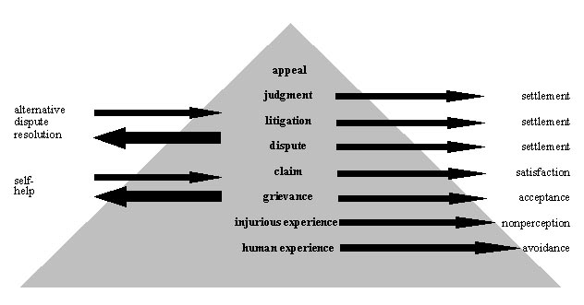
Dispute Pyramid

Slide 12
How To Engage ELS ?
Raising Questions
Proposing Hypothesis
Establishing Model: Literature Review
Data Collection
Data Analysis
Interpretation & Policy Implications

Slide 13
Data Source I: Court Data
Settlement Rate in Taiwan District Courts: 1996-2006
C
−
S
P
−
P
<
p
d
J

Slide 14
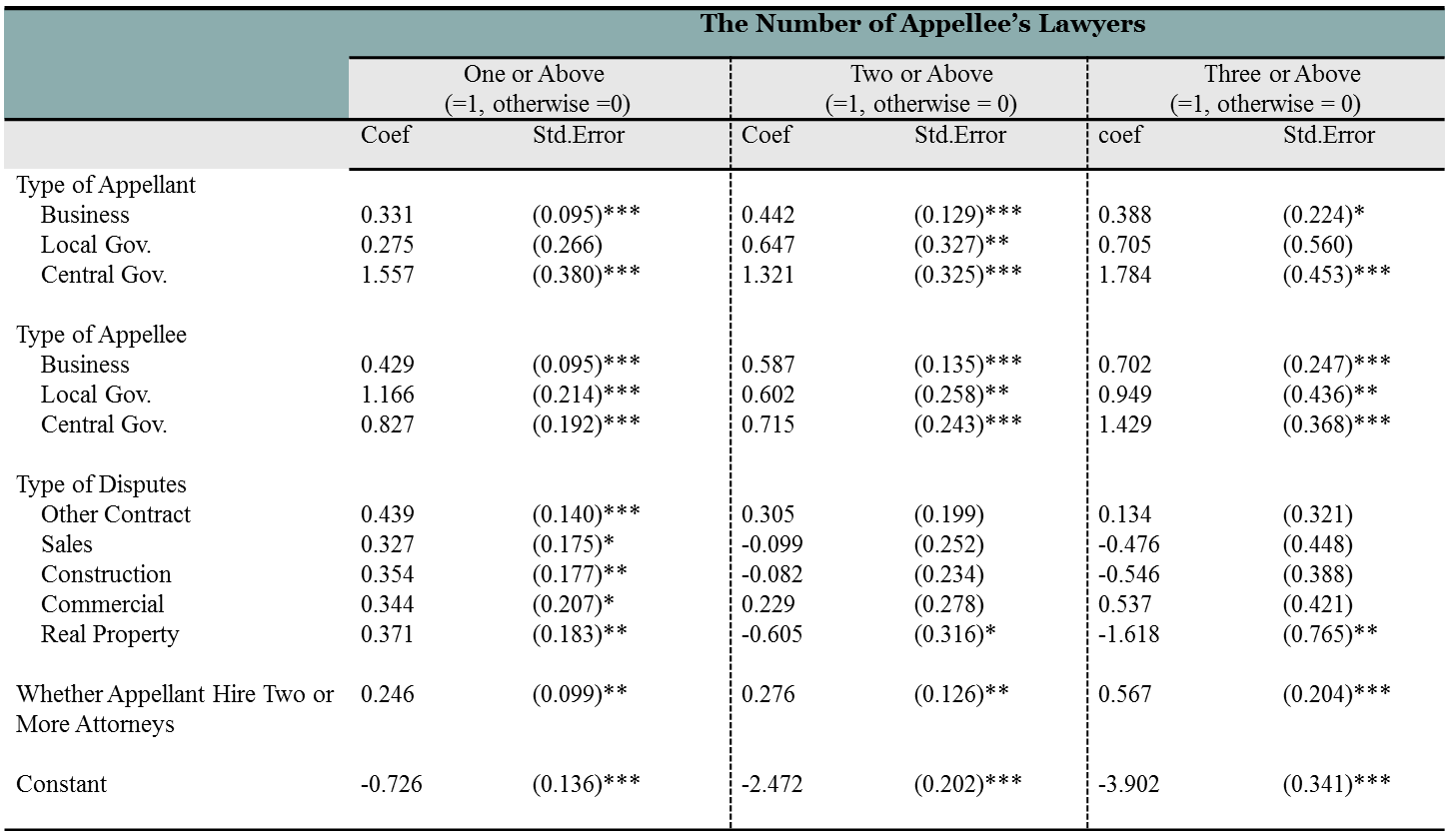
Data Source II : Coding Cases
Party Capability Theory: Haves v. Have-Nots
Parties with higher status were represented by better attorneys.
Better representations enhanced the chance of success.

Slide 15
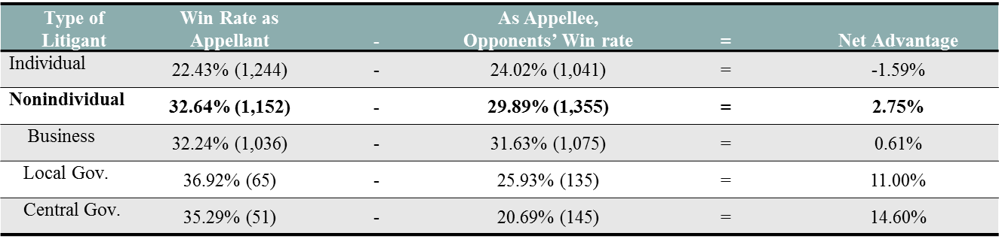
Party Capability v. Court Preference
Net Advantage of Different Types of Litigant
最高法院的偏好：「對大鯨魚優待」、 「對小蝦米殘酷」！
Net Non-dismissal Advantage of Different Types of Litigant
Type of Litigant | Non-dismissal Rate as Appellant (%) |  | - | As Appellee, Opponents’ Non-dismissal Rate (%) |  | = | Net Advantage (%)
Individual | 32.88 | (1244) | - | 34.29 | (1041) | = | -1.41
Business | 44.21 | (1036) | - | 43.91 | (1075) | = | 0.30
Local Gov. | 47.69 | (65) | - | 40.00 | (135) | = | 7.69
Central Gov. | 58.82 | (51) | - | 31.03 | (145) | = | 27.79

Slide 16
Data Source III : Field Survey
National Civil Justice Survey: Disputing Behaviors
  Little attention was paid to the process used to resolve disputes other than litigations in ELS.
  This large-scale survey could be a solid basis to provide the public sector and academia with valuable information about various topics of disputes and how people resolved them.
Design of Survey
  Modeling after Hazel Genn’s Paths to Justice
  Preparations for three years
  population: adults age 20 years and over in Taiwan
  data collection: F2F interviews, both pilot and formal surveys
  Field work: Sep. to Dec. 2011.
  sample size: 5,601 cases completed finally.

Slide 17
 Data : 2011 Disputing Behavior and Legal
Consciousness Survey in Taiwan
17

Slide 18
Theoretical Predictions
Economic analyses of settlement and suit
Assumption: PEV cases
How about NEV cases?
  the defendant will never agree to settle: No impact
  settlement in exchange for fairness and reputation becomes higher as the stakes increases: Negative impact
  Asymmetrical distribution of litigation costs: No impact.
  Divisibility of litigation costs: Positive impact.
18

Slide 19
The Analytical Framework of the Disputing Process
An aggrieved respondent
Did not raise a claim : Gave up
Raised a claim
Obtained settlement
Did not obtain settlement
 Heckman’s sample selection model: First step
 The conditional estimation of the settlement rate given that a claim is raised: Second step
19

Slide 20
Three types of explanatory variables
First type
main interest: the amount of claims
Second type
aggrieved party (claiming party) characteristics
Opponent (accused party) characteristics
Third type
including gender, age, education, and household income
including opponent type (organization v. individual) and the preexisting relationship between the two parties (yes v. no)
case type: a binary variable
20

Slide 21
Variables | Option | Percentage | Number
Amount of loss (stakes of claim) | Below USD 100 | 41.9 | 296
 | USD 100-499 | 31.3 | 221
 | USD 500-4,999 | 21.6 | 153
 | USD 5,000 and above | 5.2 | 37
Gender | Male (=1) | 50.1 | 354
 | Female (=0) | 49.9 | 343
Age | 20-29 | 27.6 | 195
 | 30-39 | 25.7 | 182
 | 40-49 | 22.2 | 157
 | 50-59 | 14.9 | 105
 | 60+ | 9.6 | 68
Education | Junior high school and below | 17.7 | 125
 | High school | 40.7 | 288
 | College and above | 41.6 | 294
Income (USD; per annum) | Less than 16,000 | 18.9 | 134
 | 16,000-47.999 | 48.9 | 346
 | 48.000+ | 10.6 | 75
 | Unknown | 21.5 | 152
Case type | Consumer cases (=0) | 50.9 | 360
 | Accident cases (=1) | 49.1 | 347
Type of opponent | Corporations (=1) | 39.0 | 274
 | Individuals (=0) | 61.0 | 428
Knowing opponent | Yes (=1) | 21.6 | 153
 | No (=0) | 78.4 | 554
Self-help strategies | Yes (=1) | 62.2 | 440
 | No (=0) | 37.8 | 267
First type
Second type
Third type
I.V.
21

Slide 22
An Overview of Descriptive Results
Of the 707 respondents observed in this study
85.9% (607)
raise a claim
Amount of Loss (Claim) | Freq.(Percent) | Claiming Rate | Settlement Rate | Litigation Rate
Below USD 100 | 296 (41.9%) | 80.7% | 61.9% | 1.1%
USD 100-499 | 221 (31.3%) | 89.6% | 63.6% | 2.8%
USD 500-4,999 | 153 (21.6%) | 89.5% | 70.1% | 24.3%
USD 5,000 and above | 37 (5.2%) | 89.2% | 60.6% | 61.5%
Total | 707 (100%) | 85.9% | 64.3% | 9.7%
Refer to Table 2 : Descriptive Statistics on Stakes and Its Effect
22

Slide 23
 Econometric Analyses
 | Claiming (yes=1 ;no=0) Equation 1 | Settlement (yes=1 ;no=0) Equation 2
Self-help Strategies (yes=1) | 0.368 (0.132) ***
Amount of Claim (logarithm) | 0.370 (0.134) *** | 0.238 (0.141) *
Amount of Claim (square of logarithm) | -0.018 (0.008) ** | -0.017 (0.008) **
Gender (male=1) | -0.323 (0.128) ** | 0.149 (0.124)
Age (logarithm) | -0.343 (0.217) | -0.168 (0.213)
Education (without high school as reference)
High School | 0.385 (0.188) ** | -0.001 (0.196)
College and Above | 0.375 (0.218) * | 0.064 (0.228)
Household Income Level (below USD 16,000 as reference)
USD 16,000-47,999 | 0.298 (0.166) * | 0.281 (0.167) *
USD 48,000 and Above | 0.735 (0.279) *** | 0.530 (0.242) **
Unknown | 0.575 (0.199) *** | 0.492 (0.192) **
Case Type (consumer disputes as reference)
Accident Disputes | -0.092 (0.166) | 0.896 (0.155) ***
TYPE OF Opponent (individual as reference)
Organizational Opponent | -0.424 (0.153) *** | 0.095 (0.156)
Preexisting Relationship with Opponent (yes=1) | 0.325 (0.162) ** | -0.066 (0.147)
Constant | 0.127 (1.016) | -1.896 (0.962) **
Observations | 707 | 607
Prob > chi2 | 0.000
Refer to Table 4 : Regression Results for Claiming Rate and Settlement Rate
23

Slide 24
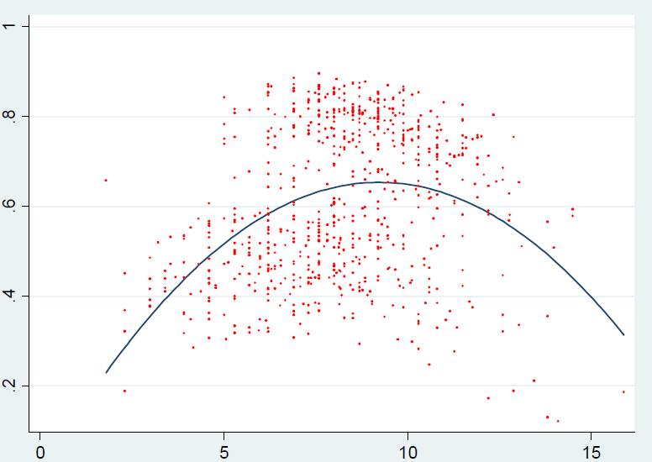
 Correlation between Probability of Settlement and Amount of Claim
Estimated Pr(Settle)
Log (Amount of Claim)
24

Slide 25
Discussion：The Impact of Stakes & Its Implications
  The claiming rate increases as the stakes become higher.
  An inverse U-shaped relation between the stakes and settlement.
    Non-small claims (PEV cases): negative effect.
    Small claims (NEV cases): positive effect.
  When the threat to sue is an issue, an increase in stakes facilitates settlement.
    The accused party did not agree to settle purely for non-economic reason.
    The concern over litigation costs provides incentives.
    A strongly positive relation between the claim amount and the settlement amount: OLS coefficient: 0.92
  The asymmetrical distribution of initial litigation costs cannot fully explain the settlement.
  The threat to sue plays an important role in the settlement mechanism.
25

Slide 26
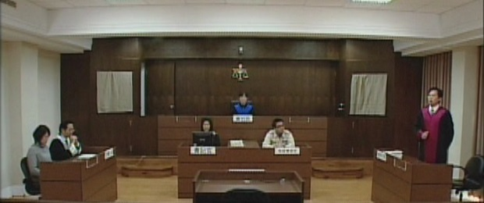
Data Sources IV: Experiments
Lay Participation – Mock Jury Trials
Aim: To understand participants' legal consciousness, attitudes and decisions regarding the fact finding and evidence evaluations.
The participants from open recruitment are asked to fill out the questionnaires before/after watching a
mock trial video,
which is adapted
from a true story
about a women
accused of
helping an ATM
scam.

Slide 27
Before Watching the Video
The participants' background information and their viewpoints of the legal system and judiciary in Taiwan are collected, for example,
  the fairness of judges, prosecutors, and police.
Guilty defendants are acquitted or
Innocent people are convicted.
Which one is more undesirable?
How does the decision rule impact jurors/juries decisions after deliberation?

Slide 28
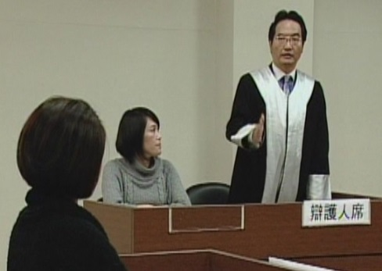
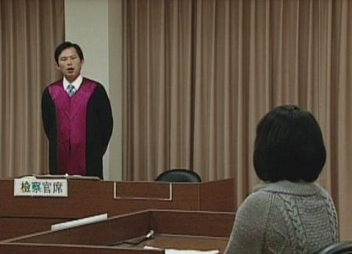
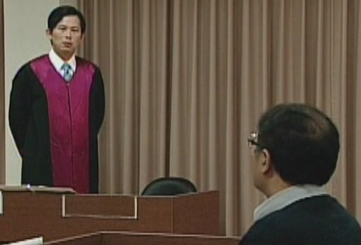
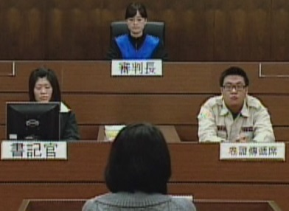
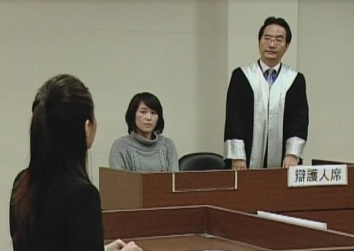
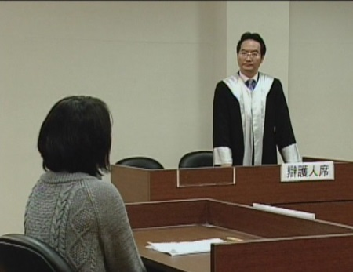
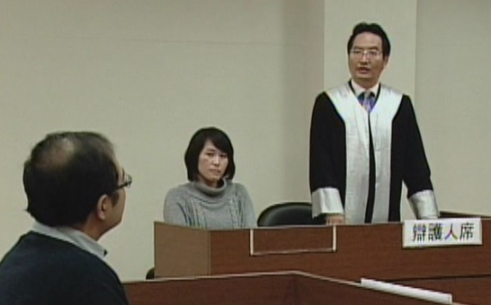
After Watching the Video
The participants are asked to respond their own decision first and degrees of confidence, and then they make a group decision, by unanimity or by majority voting, after deliberation.

Slide 29
Results: Pre-deliberation v. Post-deliberation Votes on Defendant’s Guilt
29

Slide 30
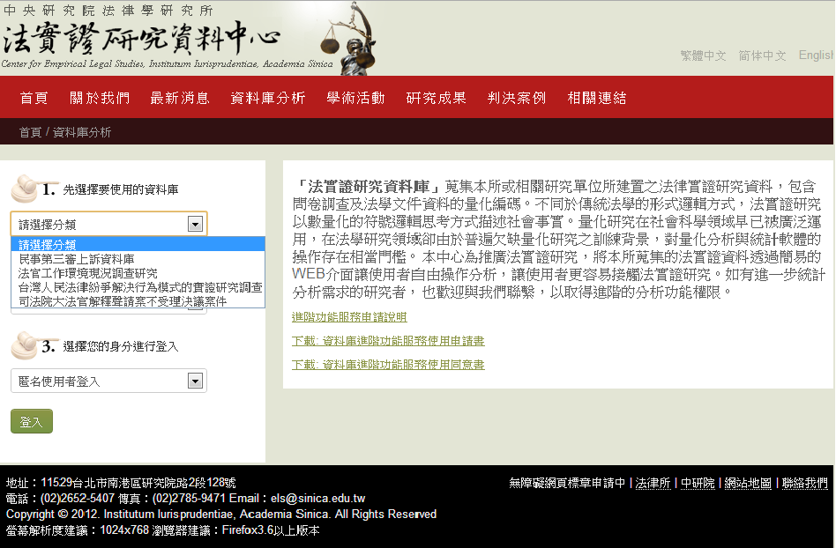
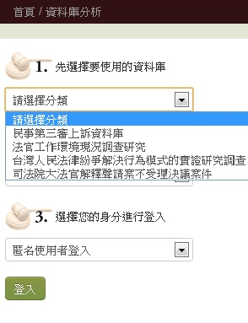
Empirical Legal Studies Database
http://www.els.iias.sinica.edu.tw/iias/public/database

Slide 31
Research Projects
The Constitutional Court in Taiwan
An Empirical Study of Medical Malpractice Cases
Building Databases for Court Cases Regarding Civil and Commercial Law Disputes
Class Actions (with Deborah Hensler)
Supreme Courts
Labor Disputes Resolution
Disputing behaviors in Taiwan
Mock Jury Trials
Evaluations of Judicial Reforms

Slide 32
K.C. Huang, K.P. Chen & C.C. Lin (2014) Party Capability Versus Court Preference: Why the “Haves” Come Out—An Empirical Lesson from Taiwan Supreme Court, Journal of Law, Economics and Organization.
黃國昌，2009年，刑事第二審制度變革之影響評估—一個實證考察之分析模組，《2008司法制度實證研究》，頁447-495。
Theodore Eisenberg & Kuo-Chang Huang (2012) The Effect of Rules Shifting Supreme Court Jurisdiction from Mandatory to Discretionary—An Empirical Lesson from Taiwan, International Review of Law & Economics.
10
Court Decisions
11
Appeal
Huang, Kuo-Chang (2008) How Legal Representation Affects Case Outcome—An Empirical Perspective from Taiwan, 5(2) J. Empirical L. Stud. 197-238.
3
黃國昌，2008年-2009年，我國勞動訴訟之實證研究──以第一審訴訟之審理與終結情形為中心（上）（下），《政大法學評論》，第106期，頁203-247；第107期，頁165-228。
Judgment
4
1
K.C. Huang, K.P. Chen & C.C. Lin (2010) Does The Type of Criminal Defense Counsel Affect Case Outcomes?—A Natural Experiment in Taiwan, International Review of Law & Economics.
settlement
litigation
5
2
6
Court
Huang, Kuo-Chang (2009) Does Discovery Promote Settlement?—An Empirical Answer, 6(2) J. Empirical L. Stud 241-278
9
K.C. Huang, K.P. Chen & C.C. Lin (2010) An Empirical Investigation of Settlement and Litigation—The Case of Taiwanese Labor Disputes, Journal of Empirical Legal Studies.
ADR
dispute
黃國昌，2009，論命拒絕共同起訴人強制追加為原告之程序機制－由實證觀點出發之考察與分析，《臺大法學論叢》，第38卷第4期，頁67-131。
7
K.C. Huang, C.C. Lin & K.P. Chen (2014) Do Rich and Poor Behave Similarly in Seeking Legal Advice?, Law & Society Review.
8
Survey
12
黃國昌、林常青、陳恭平，2010年，勞資爭議協調程序之實證研究
──以「政府協調」與「民間協調」之比較為中心，中研院法學期刊第7期。
claim
K.C. Huang & C.C. Lin (2013) Rescuing Confidence in the Judicial System—Introducing Lay Participation in Taiwan, Journal of Empirical Legal Studies.
13
grievance
K.C. Huang, K.P. Chen & C.C. Lin, How Did Workers Fare in Labor Mediation—An Empirical Assessment from Taiwan (under review).
Scale of observation / Number of Sample

Slide 33
Whether you think the court decisions generally are just (by court experience)?
33

Slide 34
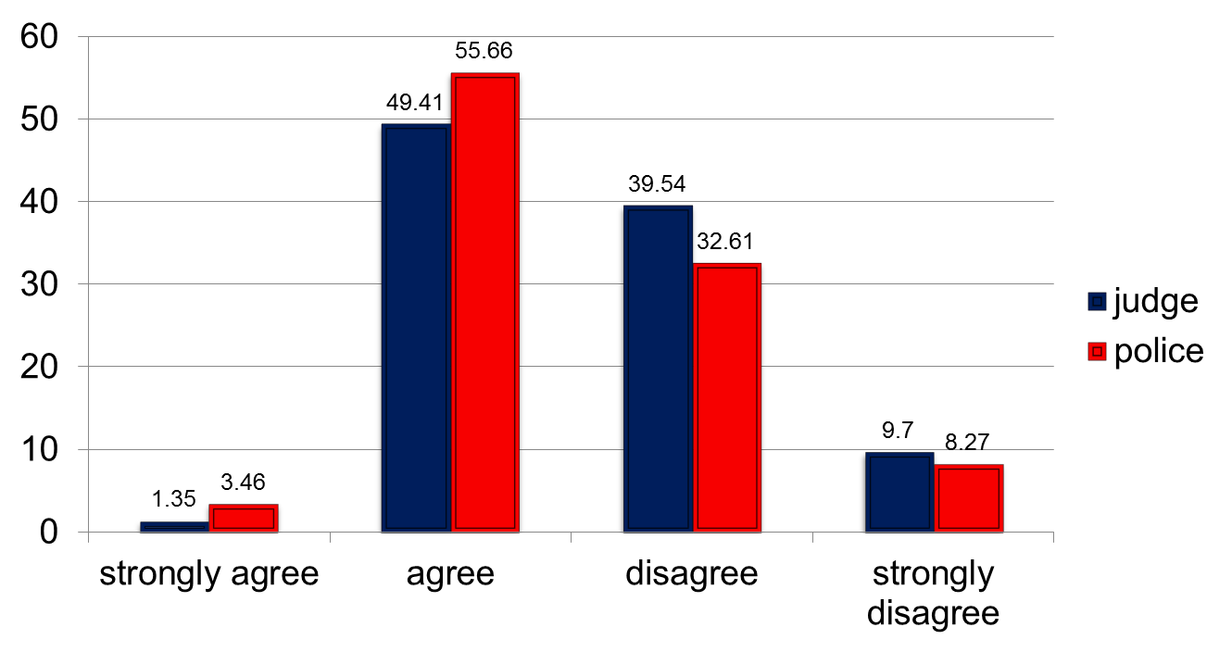
Comparison of respondents’ views on overall justness of judge decisions and police law enforcement?
34

Slide 35

Contact Us
Center for Empirical Legal Studies,
Institutum Iurisprudentiae, Academia Sinica.
Please visit us on our website http://www.els.iias.sinica.edu.tw/iias/
 els@sinica.edu.tw
 128 Academia Sinica Rd., Sec. 2,
Nankang, Taipei 11529, Taiwan.
 886-2-2652-5407 886-2-2785-9471

